Slide 1
Lecture 7
BT 203
Biochemistry
3-0-0-6
Prof. Ajaikumar B. Kunnumakkara
CANCER BIOLOGY LABORATORY
Department of Biosciences and Bioengineering
Indian Institute of Technology (IIT) Guwahati
Assam, INDIA

Slide 2
Key Concepts
What is Pentose phosphate pathway ?
Why PPP is required?
How much ATP is required for PPP?

Slide 3
Pentose phosphate pathway
While the products of glycolysis are sent through the rest of cellular respiration to produce energy, there is also an alternative branch off glycolysis to produce the sugars that make up DNA and RNA.
This pathway, called the Pentose Phosphate Pathway, is special because no energy in the form of ATP, or adenosine triphosphate, is produced or used up in this pathway.
In addition, this pathway also helps in synthesizing amino acid precursors.
It occurs in the cytosol of the cell
The generation of reducing equivalents, in the form of NADPH, used in reductive biosynthesis reactions within cells (e.g. fatty acid synthesis).
Production of ribose 5-phosphate (R5P), used in the synthesis of nucleotides and nucleic acids.
Production of erythrose 4-phosphate (E4P) used in the synthesis of aromatic amino acids.

Slide 4
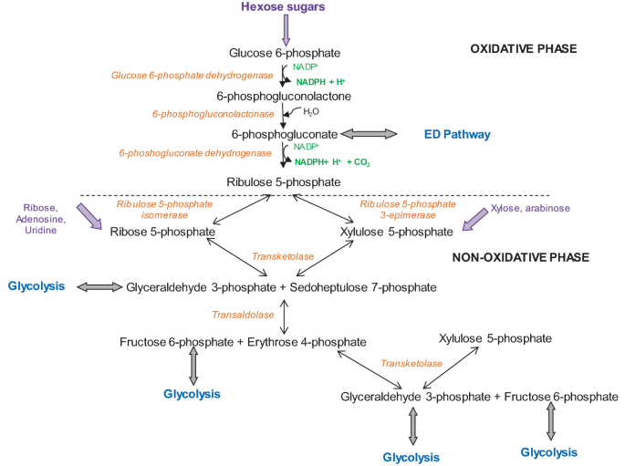
Pentose phosphate pathway

Slide 5
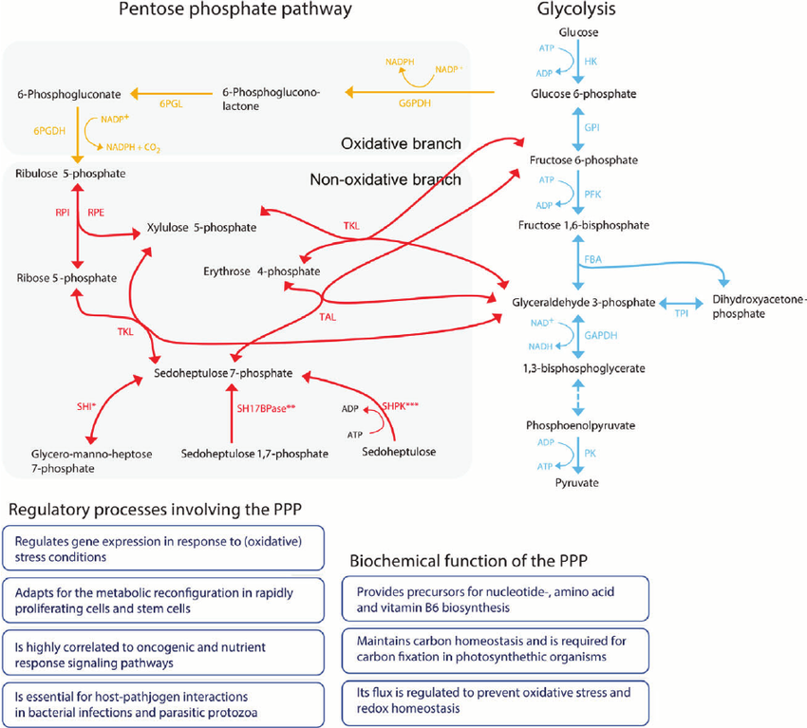
Pentose phosphate pathway

Slide 6
Pentose phosphate pathway
Cell type-specific regulation of oxidative stress by the PPP
Metabolism of glucose through the pentose phosphate pathway (PPP) influences the development of diverse pathologies.
The pentose phosphate pathway (PPP) controls oxidative stress via the production of NADPH in a cell type-specific manner.
NADPH production in red cells is dependent on the activity of glucose 6-phosphate dehydrogenase (G6PD), an enzyme in the oxidative branch of the PPP.
Diminished G6PD activity due the genetic mutations resulting in amino acid substitutions causes hemolytic anemia.
G6PD deficiency protects against malaria and Coronary Artery Disease (CAD).
G6PD is essential for NADPH production and its complete deficiency is incompatible with cell survival.
Transketolase (TK), an enzyme in the non-oxidative branch of the PPP, is essential for cell survival.
Diminished TK activity due the thiamine co-factor deficiency causes Wernicke-Korsakoff encephalopathy.
Wernicke's encephalopathy is a degenerative brain disorder caused by the lack of thiamine (vitamin B1).
Deficiency of transaldolase (TAL), an enzyme in the non-oxidative branch of the PPP, is compatible with normal development in humans and mice.
TAL regulates the PPP and causes NADPH depletion and oxidative in a cell type-specific manner.
TAL deficiency has been associated with a widening spectrum of diseases in humans and mice.

Slide 7
Pentose phosphate pathway
Several deficiencies in the level of activity (not function) of glucose-6-phosphate dehydrogenase have been observed to be associated with resistance to the malarial parasite Plasmodium falciparum among individuals of Mediterranean and African descent.
The basis for this resistance may be a weakening of the red cell membrane (the erythrocyte is the host cell for the parasite) such that it cannot sustain the parasitic life cycle long enough for productive growth.

Slide 8
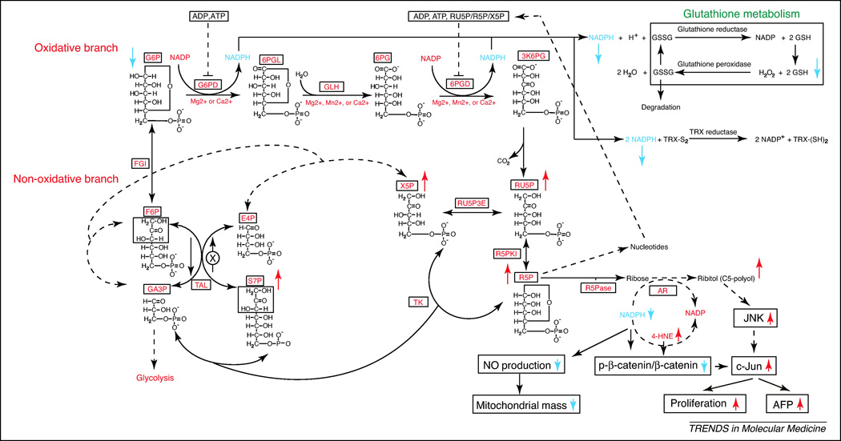
Pentose phosphate pathway

